Slide 1



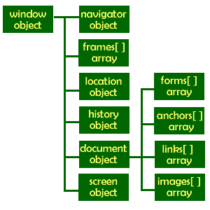

Introduction to DOM and Events
Create / Delete DOM Elements
Handle Browser Events
DOM Manipulation & Events
SoftUni Team
Technical Trainers
Software University
http://softuni.bg

Slide 2



Table of Contents
What is DOM?
Manipulating the DOM
Create Elements
Delete Elements
Element Attributes
Event Handling
Attach / Detach Events

Slide 3
Have a Question?
sli.do #front-end

Slide 4
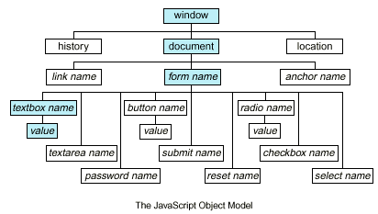
Document Object Model (DOM)
Traverse the DOM Tree

Slide 5
What is DOM?
What is Document Object Model (DOM)?
HTML documents in the browser are stored as "DOM tree"
Consists of elements with child elements
Elements have properties (attribute + value) and events
The DOM API allows search / modify the DOM tree
let menu = document.getElementById('menu');
menu.style.display = 'none';
menu.appendChild(document.createElement('hr'));

Slide 6
Selecting HTML Elements from DOM
Select a single element → returns HTMLElement
Select a collection of elements → returns a collection
let header = document.getElementById('header');
let nav = document.querySelector('#main-nav');
let root = document.documentElement;
let inputs = document.getElementsByTagName('li');
let towns = document.getElementsByName('towns[]');
let header = document.querySelectorAll('#nav li');
let allLinks = document.links;

Slide 7
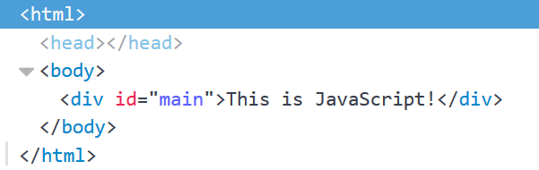
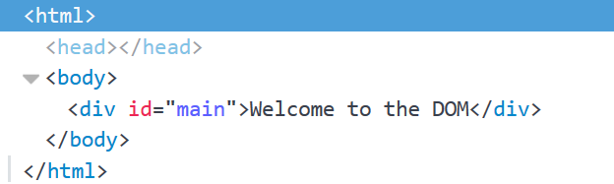
Accessing Element Text
The contents of HTML elements are stored in text nodes
To access the contents of an element:
If the element has children, returns all text concatenated
let element = document.getElementById('main');
let text = element.textContent; //This is JavaScript!
element.textContent = "Welcome to the DOM";

Slide 8
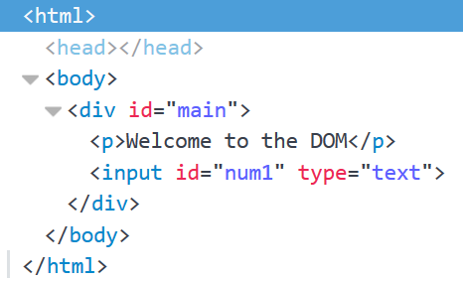
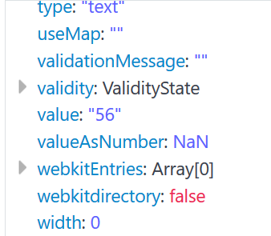
Accessing Element Values
The values of input elements are string properties on them:
let element = document.getElementById('num1');
let num = Number(element.value);
element.value = 56;

Slide 9

DOM API: Element Properties
<div id="first" class="big">First <b>DIV</b></div>
let div = document.getElementById('first');
console.log(div.id); // first
console.log(div.tagName); // DIV
console.log(div.className); // big
console.log(div.textContent); // First DIV
console.log(div.innerHTML); // First <b>DIV</b>
console.log(div.outerHTML); // <div id="first" class="big">First <b>DIV</b></div>

Slide 10
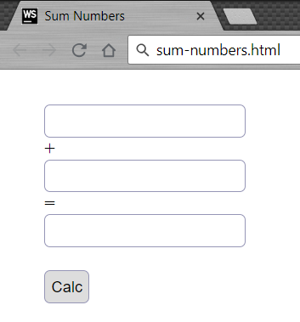
Problem: Sum Numbers
Write a JS function to sum two numbers (fill the missing code)
<input type="text" id="num1" /> +
<input type="text" id="num2" /> =
<input type="text" id="sum" readonly="readonly" />
<input type="button" value="Calc" onclick="calc()" />
<script>
function calc() {
// TODO: sum = num1 + num2
}
</script>

Slide 11
Solution: Sum Numbers
function calc() {
let num1 = document.getElementById('num1').value;
let num2 = document.getElementById('num2').value;
let sum = Number(num1) + Number(num2);
document.getElementById('sum').value = sum;
}
Check your solution here: https://judge.softuni.bg/Contests/1096

Slide 12
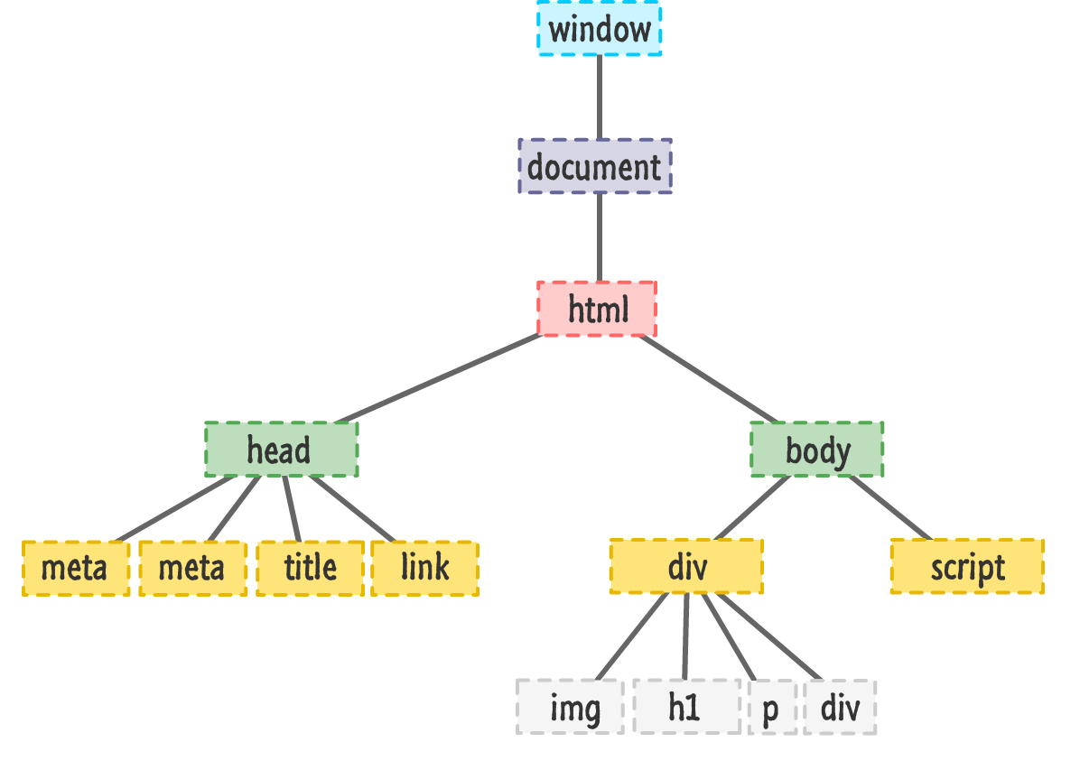
DOM Manipulation
Modify the DOM Tree

Slide 13
Creating New DOM Elements
HTML elements are created with document.createElement
Variables holding HTML elements are live:
If you modify the contents of the variable, the DOM is updated
If you insert it somewhere in the DOM, the original is moved
Text added to textContent will be escaped
Text added to innerHTML will be parsed and turned into actual HTML elements

Slide 14
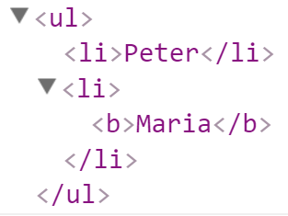
Creating New DOM Elements: Examples
let list = document.createElement("ul");
let liPeter = document.createElement("li");
liPeter.textContent = "Peter";
list.appendChild(liPeter);
let liMaria = document.createElement("li");
liMaria.innerHTML = "<b>Maria</b>";
list.appendChild(liMaria);
document.body.appendChild(list);

Slide 15
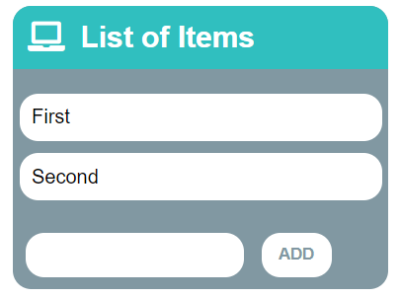
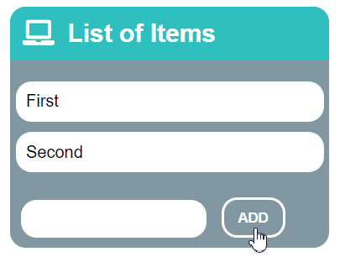
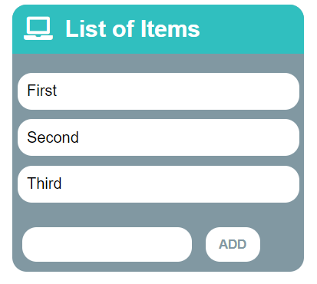
Problem: List of Items
Create a HTML page holding a list of items + text box + button for adding more items to the list
Write a JS function to append the specified text to the list

Slide 16
Problem: List of Items – HTML
<h1>List of Items</h1>
<ul id="items"><li>First</li><li>Second</li></ul>
<input type="text" id="newItemText" />
<input type="button" value="Add" onclick="addItem()">
<script>
function addItem() {
// TODO: add new item to the list
}
</script>

Slide 17
Solution: List of Items
function addItem() {
let text =
document.getElementById('newItemText').value;
let li = document.createElement("li");
li.appendChild(document.createTextNode(text));
document.getElementById("items").appendChild(li);
document.getElementById('newItemText').value = '';
}
Check your solution here: https://judge.softuni.bg/Contests/1096

Slide 18
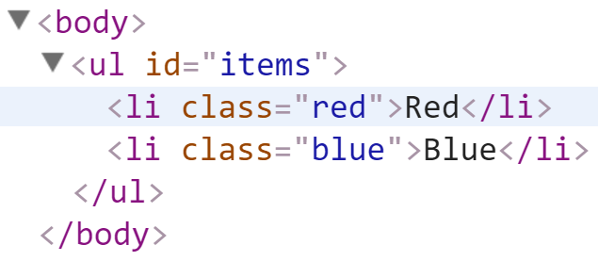
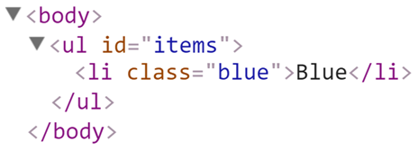
Deleting DOM Elements
<ul id="items">
<li class="red">Red</li>
<li class="blue">Blue</li>
</ul>
let redElements =
document.querySelectorAll("#items li.red");
redElements.forEach(li => {
li.parentNode.removeChild(li);
});

Slide 19
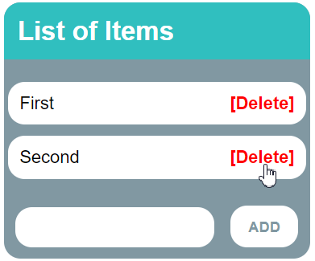
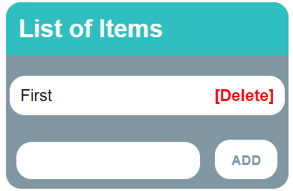
Problem: Add / Delete Items
Extend the previous problem
Implement [Delete] action as link after each list item

Slide 20
Problem: Add / Delete Items – HTML
<h1>List of Items</h1>
<ul id="items"></ul>
<input type="text" id="newText" />
<input type="button" value="Add" onclick="addItem()">
<script>
function addItem() { ...
function deleteItem() { ... }
}
</script>

Slide 21
Solution: Add / Delete Items
function addItem() {
let text = document.getElementById('newText').value;
let li = document.createElement("li");
li.appendChild(document.createTextNode(text + " "));
let span = document.createElement('span');
span.innerHTML = "<a href='#'>[Delete]</a>";
span.firstChild.addEventListener('click', deleteItem);
li.appendChild(span);
document.getElementById("items").appendChild(li);
document.getElementById('newText').value = '';

Slide 22
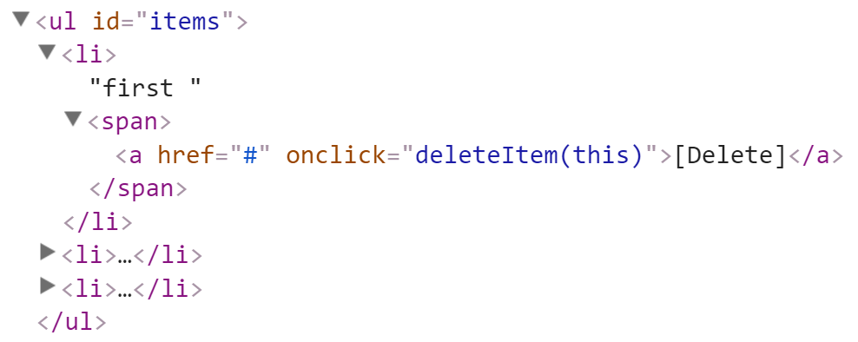
Solution: Add / Delete Items (2)
function deleteItem() {
let li = this.parentNode.parentNode;
let ul = li.parentNode;
ul.removeChild(li);
}
}
this.parentNode.parentNode == li
this.parentNode == span
this holds the clicked hyperlink
Check your solution here: https://judge.softuni.bg/Contests/1096

Slide 23
Problem: Delete from Table
<table border="1" id="customers">
<tr><th>Name</th><th>Email</th></tr>
<tr><td>Eve</td><td>eve@gmail.com</td></tr>
<tr><td>Nick</td><td>nick@yahooo.com</td></tr>
<tr><td>Didi</td><td>didi@didi.net</td></tr>
<tr><td>Tedy</td><td>tedy@tedy.com</td></tr>
</table>
<div> Email:
<label> <input type="text" name="email"/> </label>
<button onclick="deleteByEmail()">Delete</button>
<div id="result"></div></div>

Slide 24
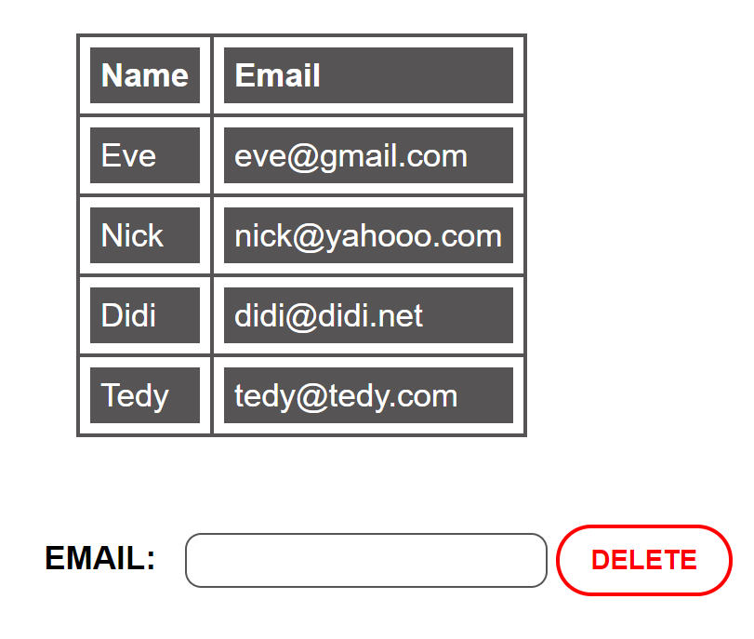
Solution: Delete from Table
function deleteByEmail() {
let email = document.getElementsByName("email")[0].value;
let secondColumn = document.querySelectorAll(
"#customers tr td:nth-child(2)");
for (let td of secondColumn)
if (td.textContent == email) {
let row = td.parentNode;
row.parentNode.removeChild(row);
document.getElementById('result').
textContent = "Deleted.";
return;
}
document.getElementById('result').textContent = "Not found.";
}

Slide 25

Practice: DOM and Events
Live Exercises in Class (Lab)

Slide 26


Summary
Browsers keep elements as DOM tree
Finding / modifying DOM elements:
Handling events:
let menu = document.getElementById('menu');
menu.style.display = 'none';
menu.appendChild(
document.createElement('hr'));
let menu = document.getElementById('menu');
menu.onclick = function(event) { … }

Slide 27







JS for Front-end – Intro to DOM and Events
https://softuni.bg/courses/javascript-for-front-end

Slide 28






SoftUni Diamond Partners

Slide 29






SoftUni Diamond Partners

Slide 30
License
This course (slides, examples, demos, videos, homework, etc.) is licensed under the "Creative Commons Attribution-NonCommercial-ShareAlike 4.0 International" license

Slide 31





Trainings @ Software University (SoftUni)
Software University – High-Quality Education, Profession and Job for Software Developers
softuni.bg
Software University Foundation
http://softuni.foundation/
Software University @ Facebook
facebook.com/SoftwareUniversity
Software University Forums
forum.softuni.bg

